Slide 1

Operating Systems
Jinghui Zhong （钟竞辉）
Office：B3-515
Email ：jinghuizhong@scut.edu.cn

Slide 2
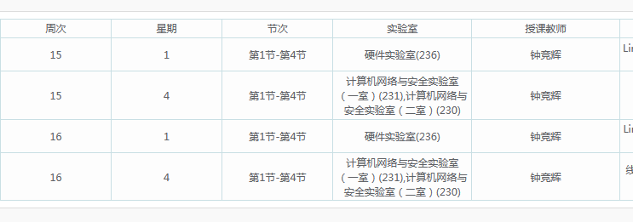
Lab Experiment Schedule

Slide 3

主观题
1分
What is the output of the following program?
main() {
int i, pid;
for (i=1; i<=3; i++) {
if ((pid = fork()) == 0) {
printf("In child %d. \n", i);
}else{
wait(&status);
}
}
}
正常使用主观题需2.0以上版本雨课堂
作答

Slide 4
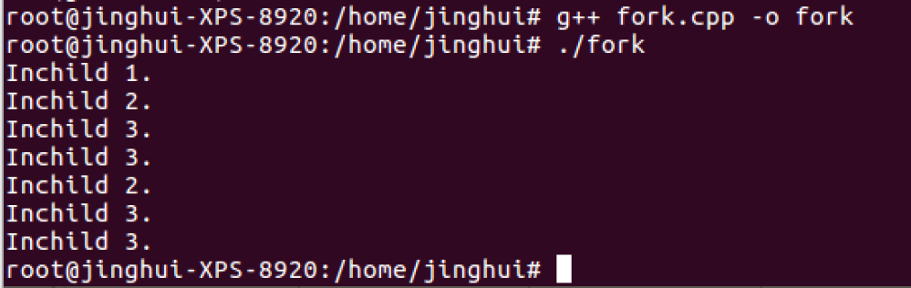
Forking Processes
main() {
int i, pid;
for (i=1; i<=3; i++) {
if ((pid = fork()) == 0) {
printf("In child %d. \n", i);
}else{
wait(&status);
}
}
}
P
I = 1
I = 2
I = 3
I = 2
I = 3
I = 3
I = 3
4

Slide 5
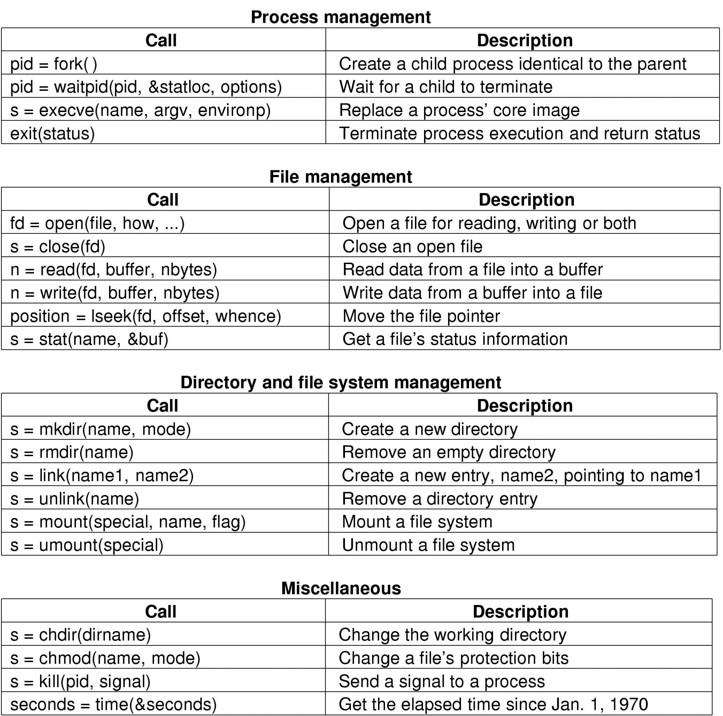
System Calls For File Management
5

Slide 6
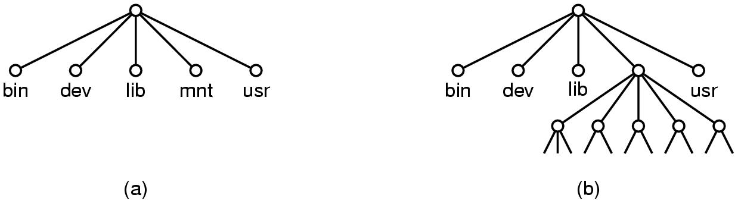
System Calls For Directory Management
mount(“/dev/fd0”, “/mnt”, 0)
6

Slide 7
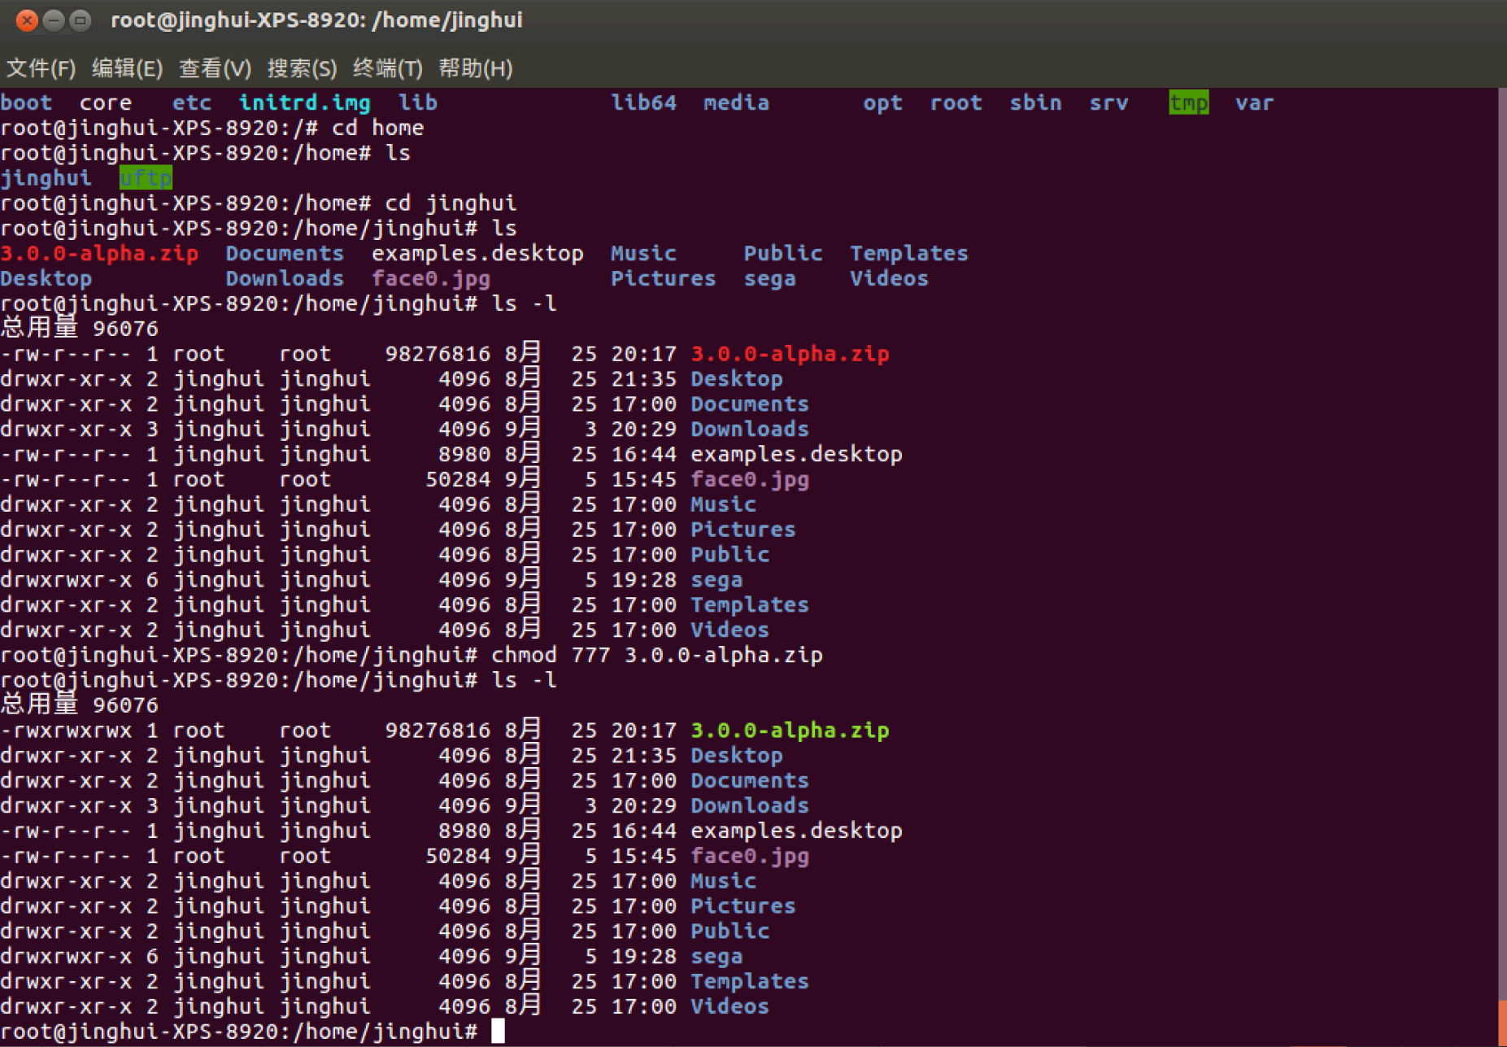
System Calls For Miscellaneous Tasks
7

Slide 8
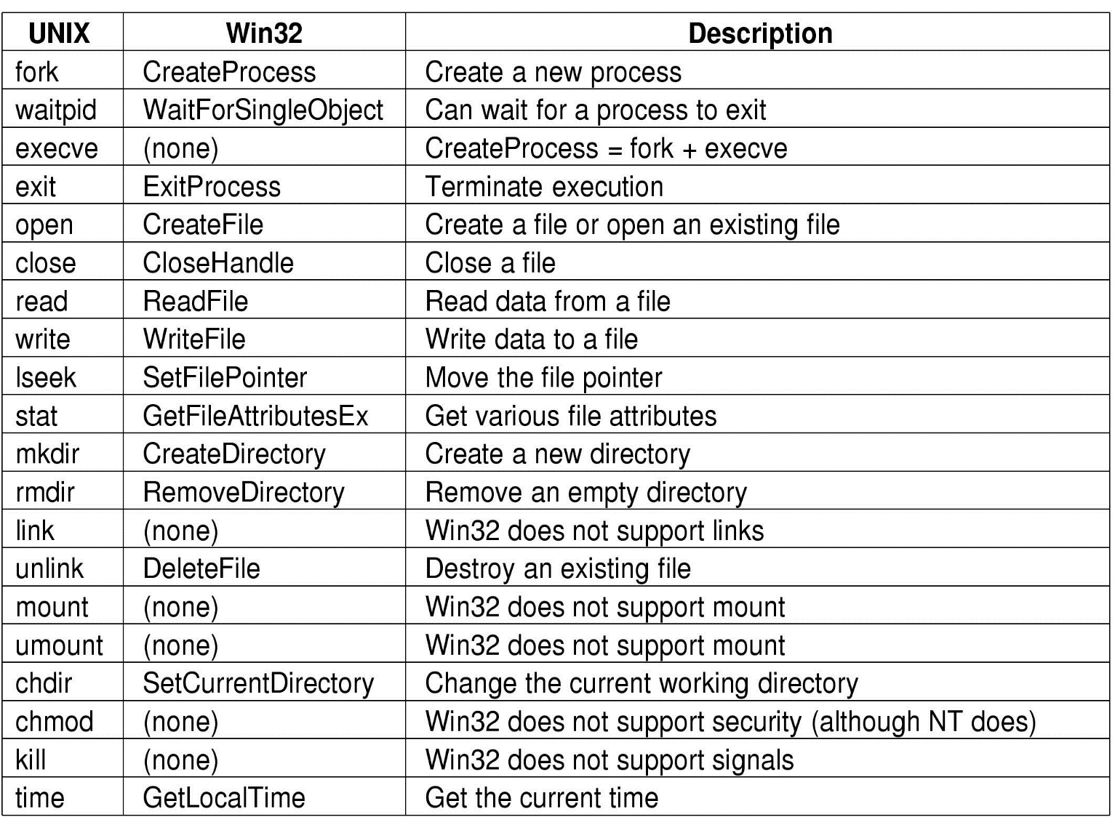
Example Win32 System Calls
8

Slide 9
System Calls (Win32)
A window program is usually event-driven.
There is almost a one-to-one relationship between the system calls of Unix and Windows, but their names are different.
Microsoft has defined Win32 API （application program interface）to get OS services.
The number of Win32 API calls is extremely large, not all of them run in kernel mode.

Slide 10
单选题
1分
The process of executing system call includes the following main operations:
Return to user mode;
execute trapped instruction;
Pass system call parameters;
execute the corresponding service program
The correct execution order is ().
A
b→c→a→d
B
b→d→c→d
C
c→b→d→a
D
c→d→b→a
提交

Slide 11
主观题
5分
What are the major functions of OS? Please list some distinct features of OS.
正常使用主观题需2.0以上版本雨课堂
作答

Slide 12
What is Operating System (OS)
A computer = Hardware + OS + User Programs
The distinct features of OS
User mode
User programs
Software
Kernel mode
Operating System
Hardware
Run in kernel mode;
Has complete access to all hardware;
Can execute any instruction the machine is capable of executing;
Huge, complex, long-lived;
Two major tasks of OS.
To provide abstractions and to manage resources

Slide 13
主观题
5分
What is a process and what are the differences between a process and a program?
正常使用主观题需2.0以上版本雨课堂
作答

Slide 14
Processes
What is a process?
a program in execution.
a container that holds all the information needed to run a program.

Slide 15
单选题
1分
The interface provided by the operating system to the application program is called（ ）
A
System calls
B
Interrupt
C
Library
D
Primitive
提交

Slide 16
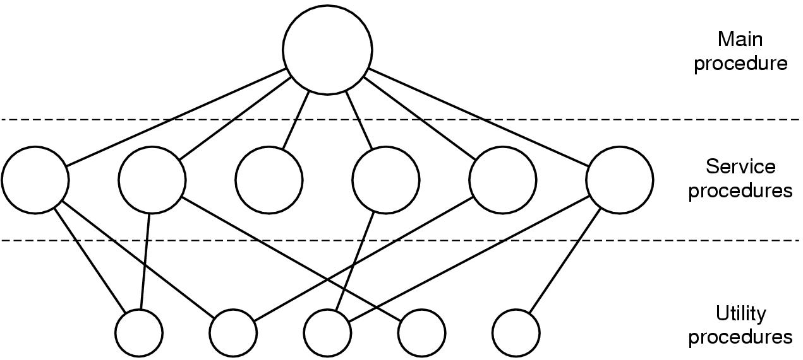
Monolithic System
All operating system operations are put into a single file. The operating system is a collection of procedures, each of which can call any of the others. (e.g., Linux, windows)
16

Slide 17

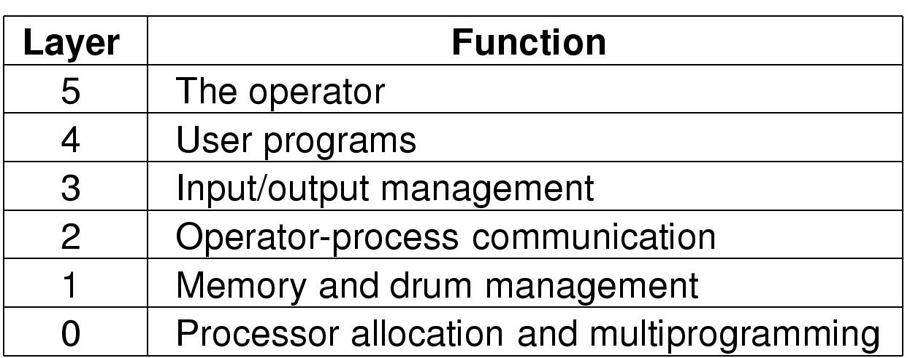
Layered System
The operating system is organized as a hierarchy of layers of processes.
Structure of the “THE” operating system,
which was built by E. W. Dijkstra and his students.
Edsger Wybe Dijkstra
17

Slide 18
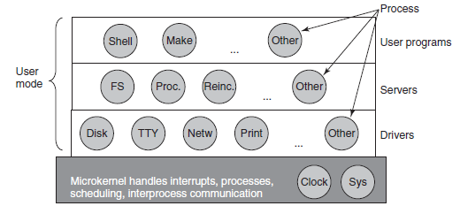
Microkernels
Split the OS into modules, only one runs in kernel mode and the rest run in user mode; (a lot communication)
Put as little as possible into kernel model to improve the reliability of the system.
Examples: MINIX 3
18

Slide 19
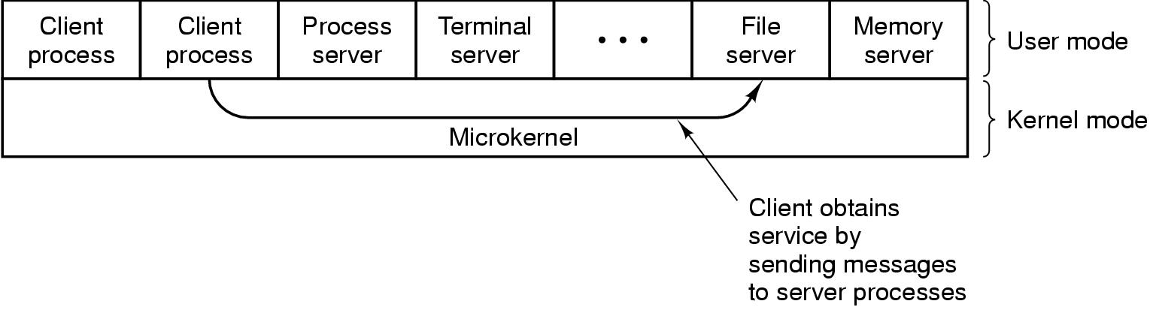
Client-Server Model
Contains two classes of processes, the servers and the clients. Communication between servers and clients is done by message passing. It is an abstraction that can be used for a single machine or a network of machines
The client-server model over a network.
19

Slide 20
单选题
1分
Which of the following description of the operating system with microkernel structure is wrong? （ ）
A
It improves the scalability of the system
B
It improves the operating efficiency of the operating system
C
It improves the reliability of the system
D
It improves the portability of the operating system
提交

Slide 21
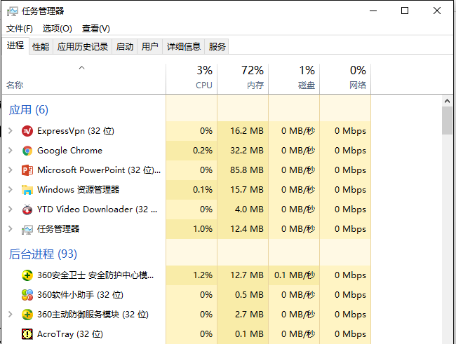
Processes
Multiprogramming：when the system is booted, many processes are running simultaneously, e.g., QQ, WeChat, etc.
21

Slide 22
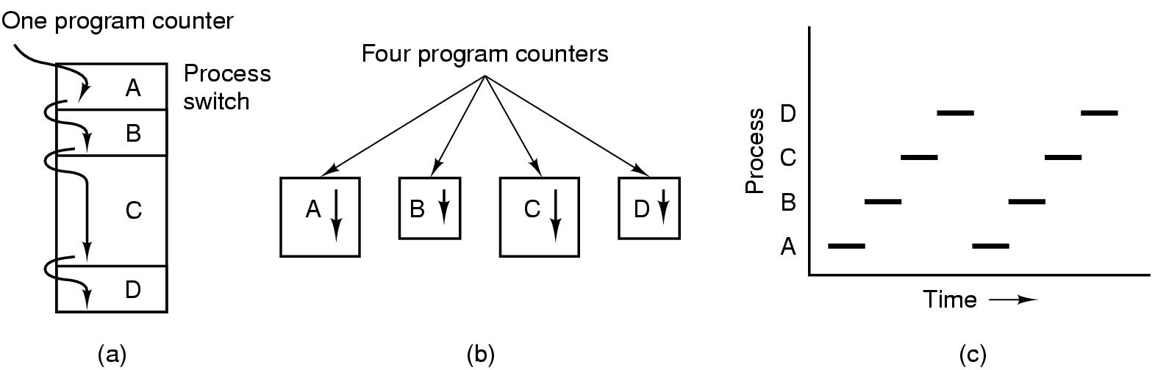
Multiprogramming
The CPU switches from process to process quickly, running each for tens or hundreds of milliseconds.
At anytime, the CPU is running only one process.
22

Slide 23
Process Creation
Events that cause process creation
System initialization
Created by a running process.
User request to create a new process
Initiation of a batch job
Foreground processes: processes that interact with users and perform work for them.
Background processes that handle some incoming request are called daemons.
23

Slide 24
Unix/Linux: Process Creation
Use fork() system call to create a new process. The execve() system call can be used to load a new program.
#include<unistd.h>
#include<sys/wait.h>
#include<stdio.h>
int main(){
int i, flag,pid,status;
for(i = 1; i<=3; i++){
if((flag=fork())==0){
printf("In child %d.\n", i);
}else{
wait(&status);
}
}
return 1;
}
24

Slide 25
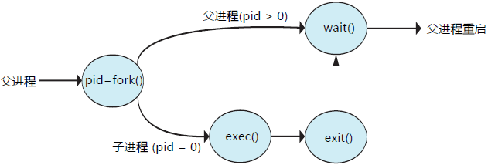
Unix/Linux: Process Creation
Related links：
http://www.cnblogs.com/hicjiajia/archive/2011/01/20/1940154.html
http://blog.csdn.net/fisher_jiang/article/details/5608399
25

Slide 26
Windows: Process Creation
Use CreateProcess to handles both creation and loading the correct program into the new process.
#include<stdio.h>
#include<windows.h>
int main(int argc,char*argv[])
{
Char szCommandLine[]="notepad";
STARTUPINFO si={sizeof(si)};
PROCESS_INFORMATION pi;
si.dwFlags=STARTF_USESHOWWINDOW;
si.wShowWindow=TRUE;
BOOL bRet=CreateProcess( NULL, szCommandLine, NULL, NULL, FALSE,
CREATE_NEW_CONSOLE, NULL, NULL, &si, &pi);
if(bRet)
{
CloseHandle(pi.hThread);
CloseHandle(pi.hProcess);
printf("New Process’s ID：%d\n",pi.dwProcessId);
printf("New Process’s main thread’s ID：%d\n",pi.dwThreadId);
}
return0;
}
26

Slide 27
Some Related Links
http://www.cnblogs.com/hicjiajia/archive/2011/01/20/1940154.html
http://blog.csdn.net/fisher_jiang/article/details/5608399
http://blog.csdn.net/bzhxuexi/article/details/23950701
https://www.youtube.com/watch?v=xHu7qI1gDPA&list=PLegzNeGav1mcwCib09iz4ioSGDjPB34Ff
https://www.youtube.com/watch?v=xVSPv-9x3gk
27

Slide 28
Process Termination
Conditions that cause process termination
Normal exit (voluntary)
“Exit” in UNIX and “ExitProcess” in Windows.
Error exit (voluntary)
Example: input file is not exist.
Fatal error (involuntary)
Example: referencing nonexistent memory.
Killed by another process (involuntary)
“Kill” in UNIX and “TerminateProcess” in Windows.
28

Slide 29
Process Termination
Win32 API for Process termination
1）get window handle by FindWindow()；
2）get process id by GetWindowThreadProcessId()；
3）get process handle by openprocess() ；
4）TerminateProcess().
int CStaticFunc::KillProcess(LPCSTR pszClassName, LPCSTR pszWindowTitle) { HANDLE hProcessHandle; ULONG nProcessID; HWND TheWindow; TheWindow = ::FindWindow( NULL, pszWindowTitle ); ::GetWindowThreadProcessId( TheWindow, &nProcessID ); hProcessHandle = ::OpenProcess( PROCESS_TERMINATE,
FALSE, nProcessID); return ::TerminateProcess( hProcessHandle, 4 ); }
29

Slide 30
Process States
A single process in running state
Running
…
…
Blocked
Ready
Multiple processes
Multiple processes
Running：using the CPU at that instant.
Ready：runnable; temporarily stopped to let another process run.
Blocked：unable to run until some external event happens.

Slide 31
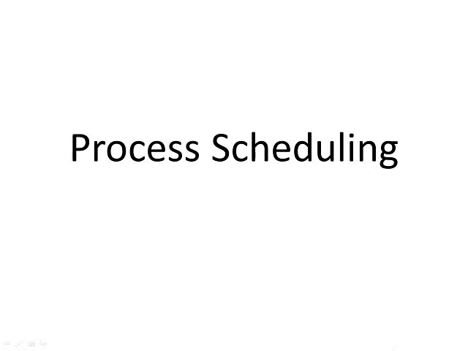
31

Slide 32
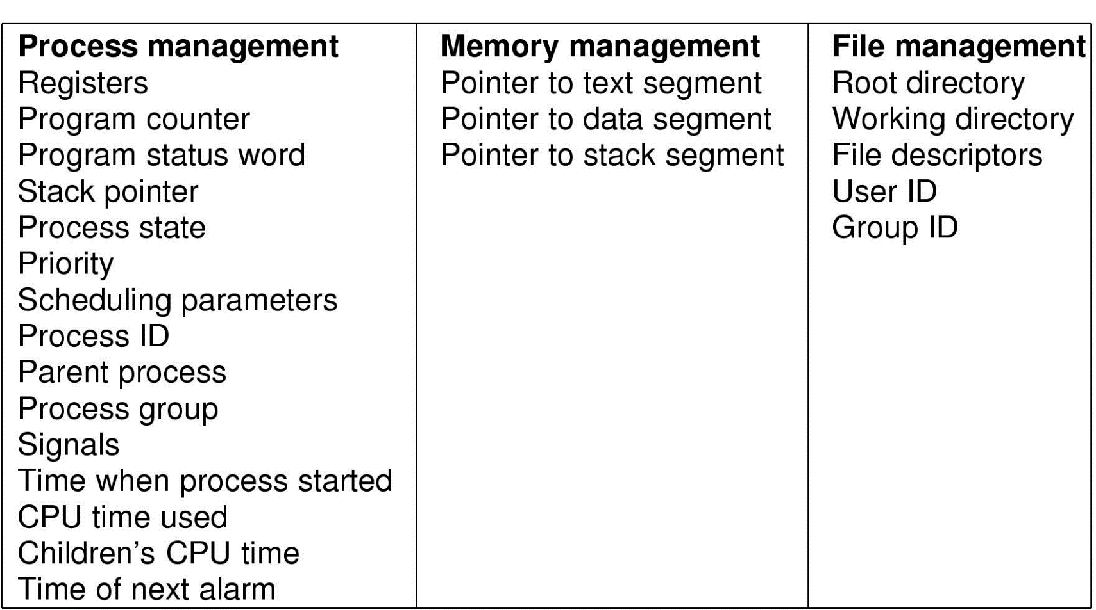
Implementation of Processes
The OS maintains a Process Table with one entry (called a process control block (PCB)) for each process.
32

Slide 33


Slide 34
Implementation of Processes
When a context switch occurs between processes P1 and P2, the current state of the RUNNING process, say P1, is saved in the PCB for process P1 and the state of a READY process, say P2, is restored from the PCB for process P2 to the CPU registers, etc. Then, process P2 begins RUNNING.
Pseudo- parallelism : the rapid switching between processes gives the illusion of true parallelism and is called pseudo-parallelism.
34

Slide 35
主观题
1分
Suppose a process spends a fraction p of its time waiting for I/O to complete. With n processes in memory at once. What is the CPU utilization rate?
正常使用主观题需2.0以上版本雨课堂
作答

Slide 36
Modeling Multiprogramming
Suppose a process spends a fraction p of its time waiting for I/O to complete. With n processes in memory at once. The CPU utilization can be obtained by:
CPU utilization = 1 – p^{n}
36

Slide 37
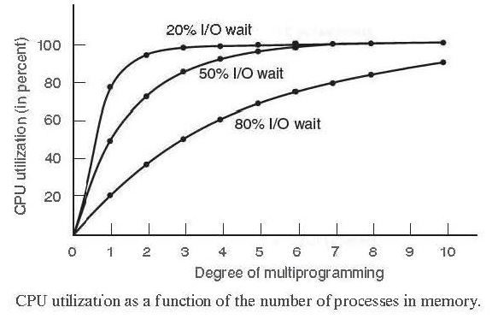
CPU Utilization in Multiprogramming
CPU utilization = 1 – p^{n}

Slide 38
单选题
1分
Which state transition is impossible（ ）
A
ready → running
B
running→ready
C
running→blocked
D
ready →blocked
提交

Slide 39
单选题
1分
A process is awaken from blocked state, indicating that（ )
A
The process is using the CPU again
B
Its priority becomes maximum
C
PCB moves to the top of the ready queue
D
The process is inserted into ready queue
提交

Slide 40
Thread
What is a thread?
A thread of execution is the smallest sequence of programmed instructions that can be managed independently by a scheduler, which is typically a part of the operating system. The implementation of threads and processes differs between operating systems, but in most cases a thread is a component of a process. Multiple threads can exist within one process, executing concurrently and sharing resources such as memory, while different processes do not share these resources. In particular, the threads of a process share its executable code and the values of its variables at any given time.
40

Slide 41
Thread
What is a thread?
A thread of execution is the smallest sequence of programmed instructions that can be managed independently by a scheduler, which is typically a part of the operating system. The implementation of threads and processes differs between operating systems, but in most cases a thread is a component of a process. Multiple threads can exist within one process, executing concurrently and sharing resources such as memory, while different processes do not share these resources. In particular, the threads of a process share its executable code and the values of its variables at any given time.
41

Slide 42
Thread
Why do we need threads?
Responsiveness: multiple activities can be done at the same time.
Resource Sharing: threads share the memory and the resources of the process.
Economy: threads are easy to create and destroy.
Utilization of MP (multiprocessor) Architectures: threads are useful on multiple CPU systems.
42

Slide 43
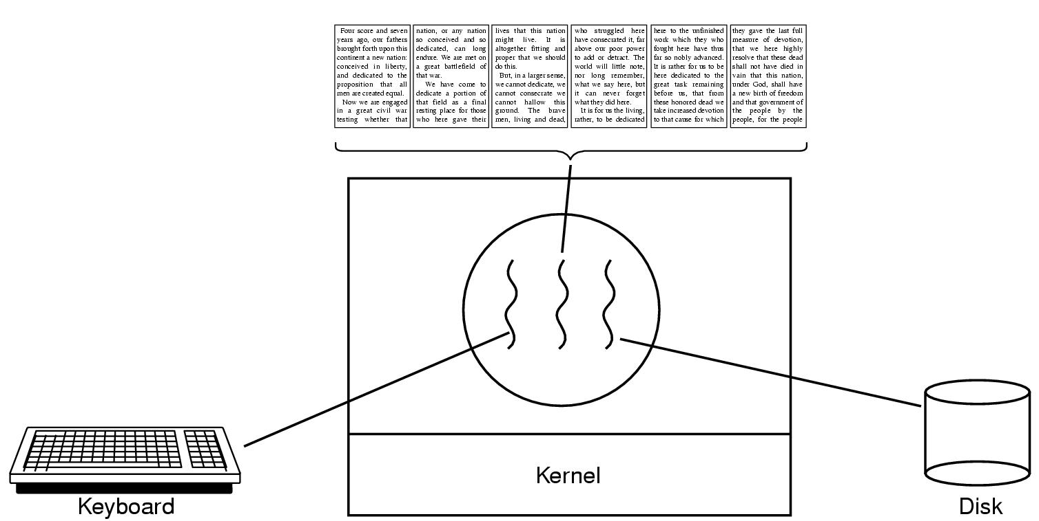
Thread Usage Example
A word processor with three threads
43

Slide 44
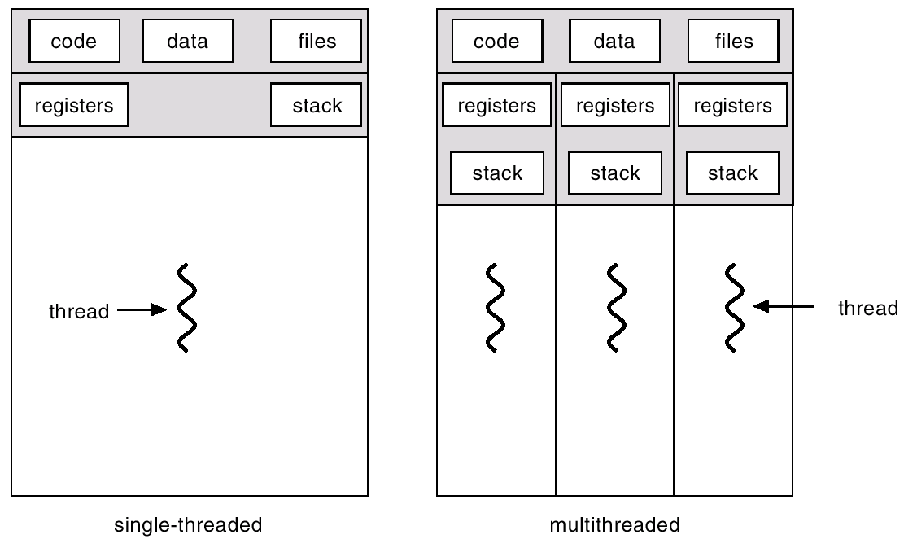
Single-threaded and Multithreaded Processes
44

Slide 45
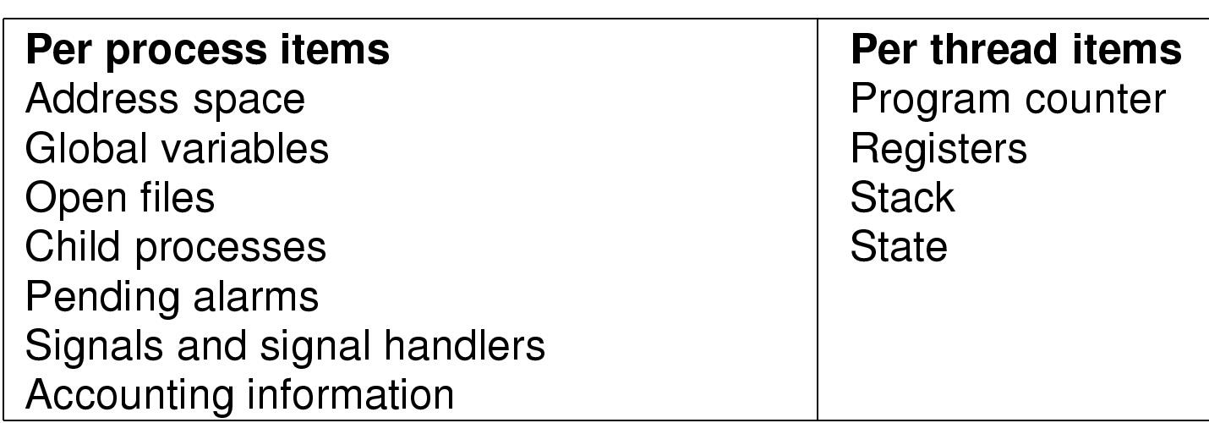
Thread Model
Some items are shared by all threads in a process, while some items are private to each thread
45

Slide 46
Linux: How to Create a Thread?
#include<stdio.h>
#include<string.h>
#include<pthread.h>
#include<stdlib.h>
#include<unistd.h>
pthread_t tid[2];
void* doSomeThing(void *arg)
{
unsigned long i = 0; pthread_t id = pthread_self();
if(pthread_equal(id,tid[0])) { printf("first\n"); }
else { printf("Second\n");}
return NULL;
}
int main(void) {
int i = 0; int err;
while(i < 2) {
err = pthread_create(&(tid[i]), NULL, &doSomeThing, NULL);
if (err != 0) printf("error\n"); else printf("successfully\n"); i++;
}
return 0;
}
46

Slide 47
Windows: How to Create a Thread?
#include "windows.h"
HANDLE CreateThread( LPSECURITY_ATTRIBUTES lpThreadAttributes, // pointer to security attributes DWORD dwStackSize, // initial thread stack size LPTHREAD_START_ROUTINE lpStartAddress, // pointer to thread function LPVOID lpParameter, // argument for new thread DWORD dwCreationFlags, // creation flags LPDWORD lpThreadId // pointer to receive thread ID );
e.g.,
DWORD WINAPI thread (PVOID ID) { xxx }
CreateThread(NULL, 0, thread, &ID, 0, &v);
47

Slide 48
Thread vs. Process
A thread – lightweight process, a basic unit of CPU utilization.
It comprises a thread ID, a program counter, a register set, and a stack.
A traditional (heavyweight) process has a single thread of control.
If the process has multiple threads of control, it can do more than one task at a time. This situation is called multithreading.
Process：used to group resources together;
Thread：the entity scheduled for execution on the CPU.
48

Slide 49
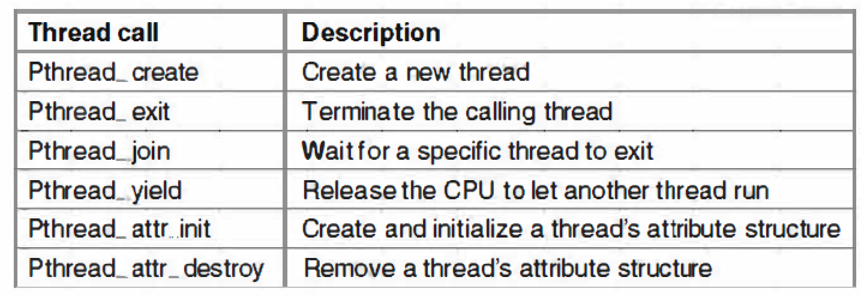
POSIX Threads
POSIX (Portable Operating System Interface) is a set of standard operating system interfaces based on the Unix operating system.
The need for standardization arose because enterprises using computers wanted to be able to develop programs that could be moved among different manufacturer's computer systems directly.
49

Slide 50
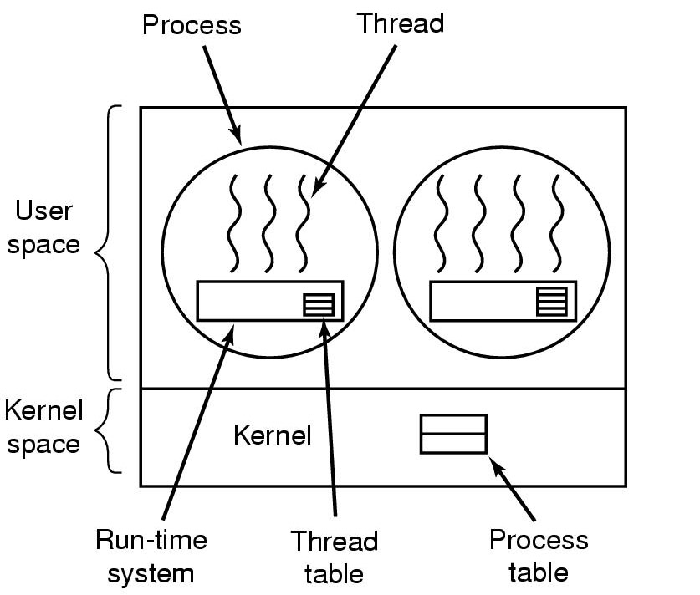
Implementing threads in user space
Advantages: fast, flexible, scalable
Drawbacks：
1) Blocking blocks all threads in a process;
2) No thread-level parallelism on multiprocessor.
50

Slide 51
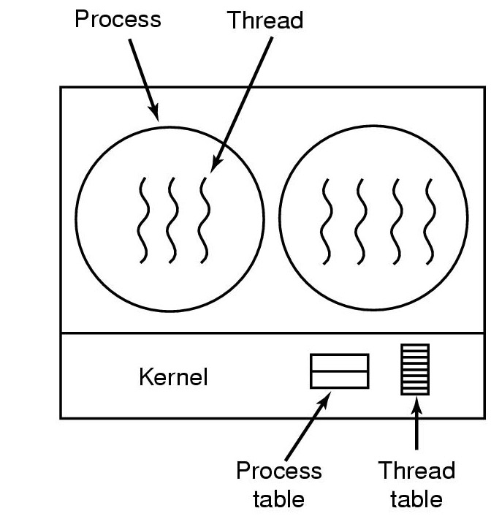
Implementing threads in kernel
Advantages: Blocking blocks only the appropriate thread in a process; Support thread-level parallelism on multiprocessor;
Disadvantages: Slow thread management; large thread tables
51

Slide 52
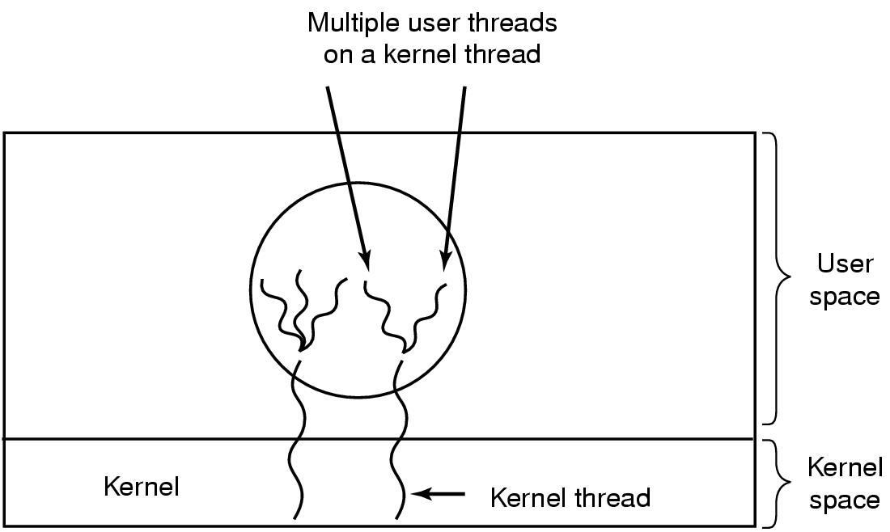
Hybrid Implementations
Multiplex user-level threads on kernel threads. Kernel is only aware of the kernel-level threads and schedule those.
More flexible, but more complicated.
52

Slide 53
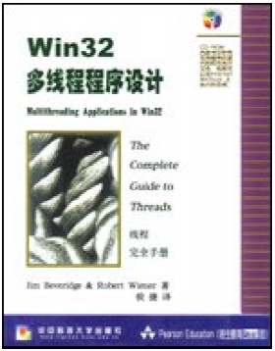
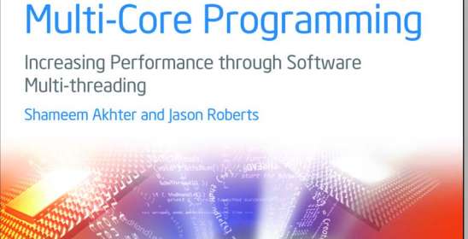
Multithread Programming
Multithreading applications in Win32
53

Slide 54
单选题
1分
In a system that supports multithreading, what cannot be shared among threads created by process P（ ）
A
Code of process P
B
Files open in P
C
Global variables of process P
D
Stack pointer of a thread in process P
提交

Slide 55
单选题
1分
Which description is correct（ ）
A
Whether the system supports threads or not, the process is the basic unit of resource allocation
B
Thread is the basic unit of resource allocation and process is the basic unit of scheduling
C
Both system level thread and user level thread switch need kernel support
D
Each thread in the same process has its own address space
提交

Slide 56
多选题
1分
The advantages of multiprogramming system are （ ）
A
High CPU utilization
B
Low system overhead
C
High system throughput
D
High utilization of I / O devices
提交

Slide 57
Check points
The features of common OS structure.
How many states can a process have?
How to create and terminate a process in Windows?
What is PCB?
What is Context Switch?
What is thread?
What are the differences between process and thread？

